Slide 1
Lecture 04: Advanced Scheduling
CS343 – Operating Systems
Branden Ghena – Fall 2022
Some slides borrowed from: Wang Yi (Uppsala), and UC Berkeley CS149 and CS162

Slide 2
Today’s Goals
Describe real-time systems
Understand scheduling policies based on deadlines
Explore modern operating system schedulers

Slide 3
Outline
Scheduling Overview
Scheduler Metrics
Batch Systems
First In First Out scheduling
Shortest Job First scheduling
Shortest Remaining Processing Time scheduling
Interactive Systems
Round Robin scheduling
Multi-Level Feedback Queue scheduling

Slide 4
Jobs can be I/O-bound or CPU-bound
CPU-bound process
Lots of computation between each I/O request
Actually needs to do computation on a processor
Example: doing matrix math
I/O-bound process
Very little computation between each I/O request
Just needs a processor to figure out its next I/O request
Example: searching a file system for a file name

Slide 5
Scheduling goal: I/O-bound before CPU-bound
First maximize I/O
Run the I/O-bound jobs as quickly as possible,
So they can send next I/O request,
And our disks, network cards, etc. are maximally used
And our processor becomes free again quickly (faster than a timeslice)
Then fill up the processor(s)
Lots of room for multiprogramming between the I/O requests
Blocked jobs are still “progressing” as their I/O is fetched

Slide 6
Scheduling goal: I/O-bound before CPU-bound
First maximize I/O
Run the I/O-bound jobs as quickly as possible,
So they can send next I/O request,
And our disks, network cards, etc. are maximally used
Then fill up the processor(s)
Lots of room for multiprogramming between the I/O requests
Blocked jobs are still “progressing” as their I/O is fetched
But how do you know when a job is going to use I/O?
Can’t know the future
Can track past behavior of the job

Slide 7
2. Multi-Level Feedback Queue (MLFQ)
General purpose scheduler to support multiple goals
Good response time for interactive jobs
Good turnaround time for batch jobs
Achieves this by prioritizing I/O bound jobs over CPU bound jobs
Policy
Automatically attach priority to jobs:
Interactive, I/O bound jobs should be highest priority
CPU bound, batch jobs should be lowest priority
Apply different round robin timeslices to each priority level

Slide 8
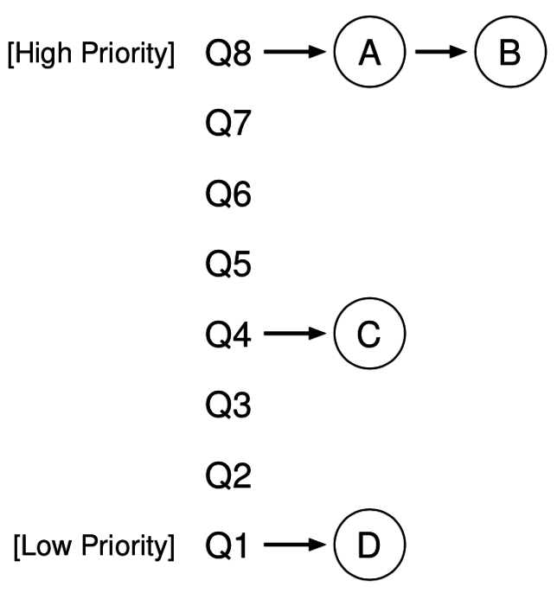
Multi-Level Feedback Queue Details
Run highest priority level available
Round robin among jobs there
When all jobs at a level are blocked on I/O
Move down to next lower level
Long running jobs lose priority
Processor usage quota at a given level
When used up, demote job one level

Slide 9
MLFQ Rules
If Priority(J₁) > Priority(J₂), J₁ runs
If Priority(J₁) = Priority(J₂), J₁ and J₂ run in Round Robin
Jobs start at top priority
When a job uses its time quota for a level, demote it one level
Every S seconds, reset priority of all jobs to top

Slide 10
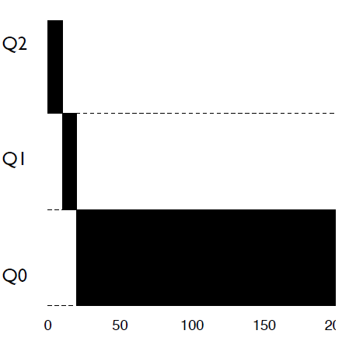
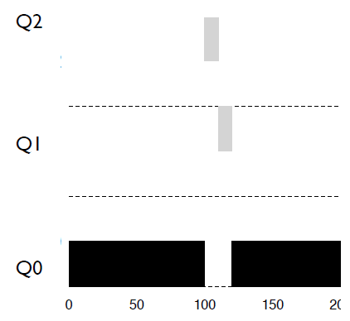
MLFQ Example
Higher priority jobs run first
Job’s priority drops as it runs
Priority
Time
Time

Slide 11
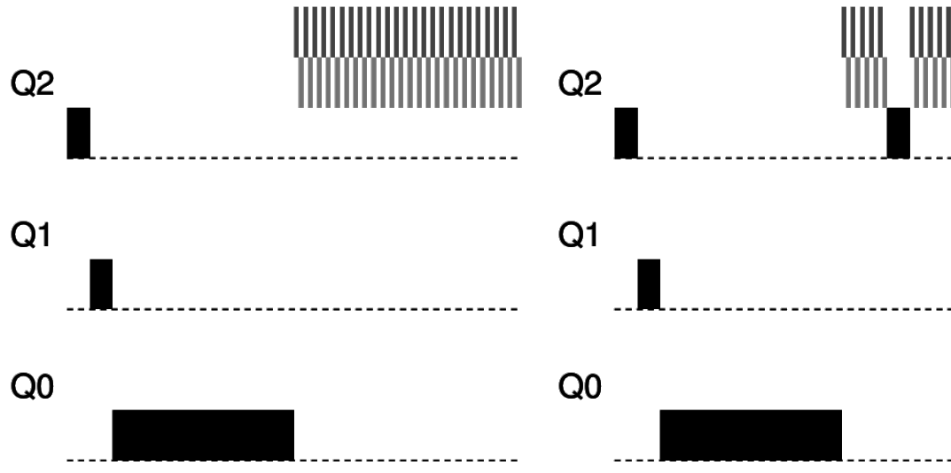
MLFQ avoids starvation with periodic priority reset
Low priority jobs could starve if there are enough interactive jobs
MLFQ avoids starvation by periodically resetting priorities
Many new interactive jobs
Priority reset
Time
Time

Slide 12
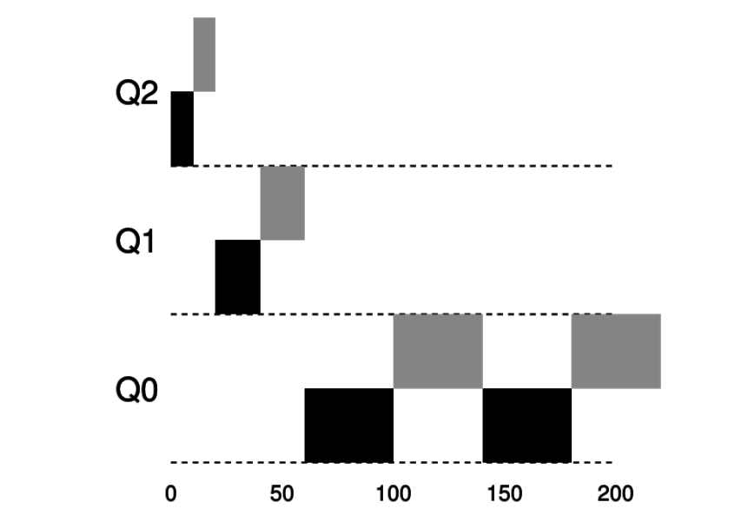
Change timeslices to optimize response and turnaround
Lower priority jobs are CPU bound, not interactive
So we can use longer timeslices to minimize context switches
Priority
Time

Slide 13
MLFQ parameters
Every MLFQ implementation needs to choose a bunch of parameters
How many queues/priority levels?
When does a job get demoted in priority?
How often to reset priority for everything?
How large is the timeslice at each priority level?

Slide 14
MLFQ in the wild
The embedded OS I work on has an MLFQ scheduler!
https://github.com/tock/tock/blob/master/kernel/src/scheduler/mlfq.rs
How many queues/priority levels?
Three
When does a job get demoted in priority?
If it ever uses its whole timeslice without blocking
How often to reset priority for everything?
Every five seconds
How large is the timeslice at each priority level?
10 ms, 20 ms, 50 ms

Slide 15
Outline
Real Time Operating Systems
Earliest Deadline First scheduling
Rate Monotonic scheduling
Modern Operating Systems
Linux O(1) scheduler
Lottery and Stride scheduling
Linux Completely Fair Scheduler

Slide 16
Normal OSes don’t cut it for all use cases
Some environments need very specialized systems
Flight controls
Autonomous vehicles
Space exploration
In each of these scenarios
Computer failures are unacceptable
Humans can’t intervene to resolve issues
We’re going to need a computer system with performance guarantees

Slide 17
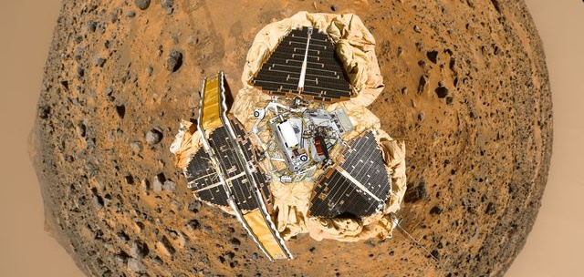
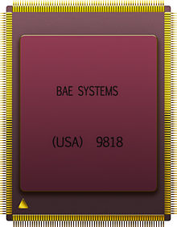
Example: Pathfinder
Radiation-hardened IBM CPU

Slide 18
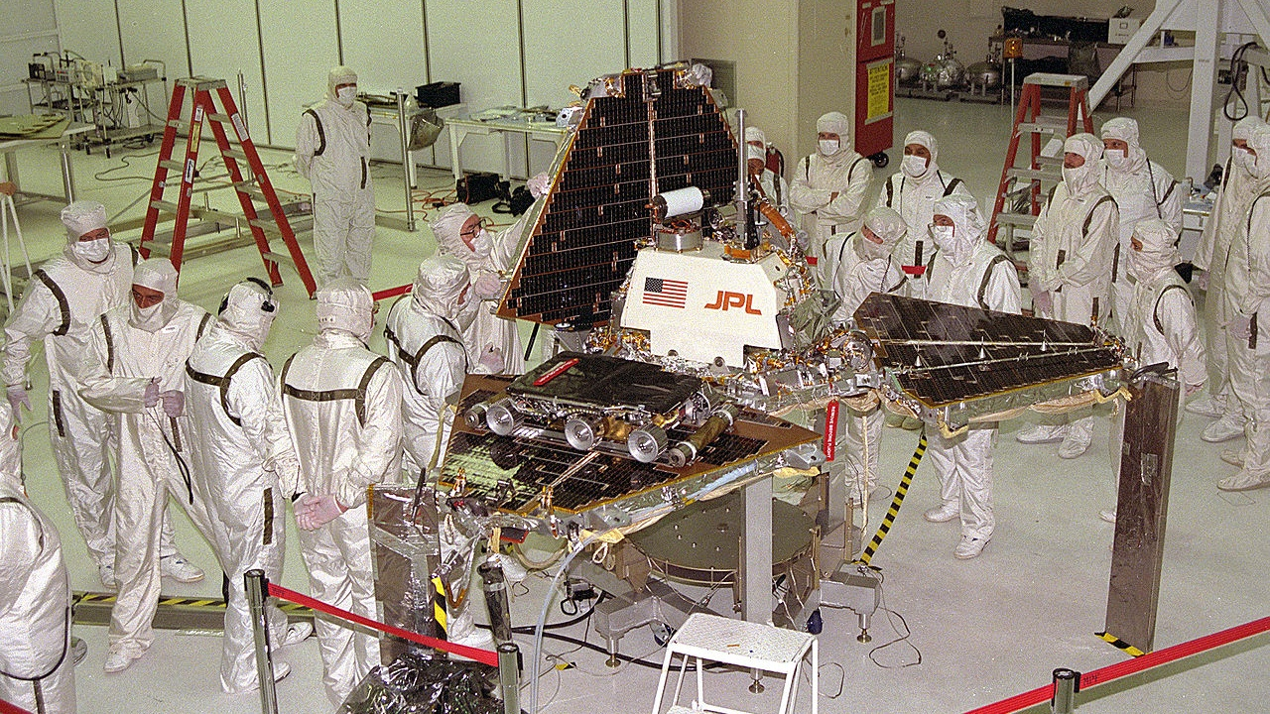
Notes:
Sojourner is the robot
Pathfinder is the lander

Slide 19
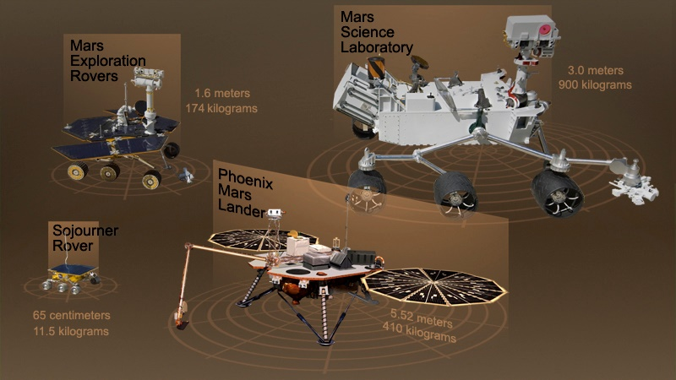
Notes:
Aside: put into perspective how big these things are

Slide 20
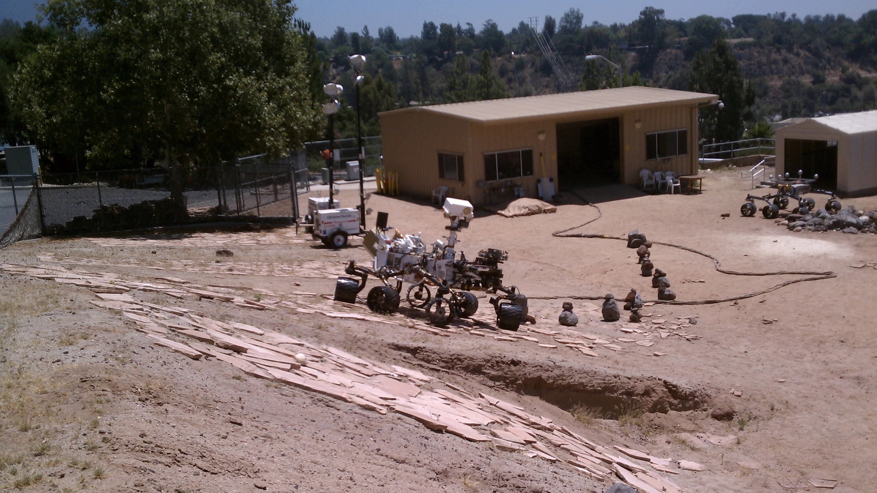
Notes:
Aside: here’s a picture of the second-curiosity they’ve got at NASA JPL for testing purposes

Slide 21
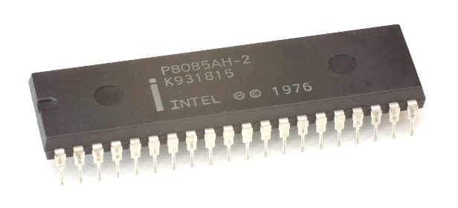
Pathfinder had periodic tasks that must be executed
Tasks to execute
Scheduler (kernel)
Manage Bus
Comms
Weather Report
Comms
Manage Bus
Weather Report
time

Slide 22
Real-Time Operating Systems
Goal: guaranteed performance
Meet deadlines even if it means being unfair or slow
Limit how bad the worst case is
Usually mathematically
It’s not about speed, it’s about guaranteed performance
Good turnaround and response time are nice, but insufficient
Predictability is key to providing a guarantee
RTOS is actually a whole other class worth of material
Last taught by Peter Dinda in 2005…

Slide 23
Types of real-time schedulers
Hard real-time:
Meet all deadlines
Otherwise decline to accept the job
Ideally: determine in advance if deadlines will be met
Soft real-time
Attempt to meet deadlines with high probability
Often good enough for many non-safety-critical applications
Quadcopter software

Slide 24
Real-time jobs
Preemptable jobs with known deadlines (D) and computation (C)
Computation duration here are the worst-case execution times
Computation MUST complete before deadline and start after arrival
Can happen anywhere between those boundaries though
Computation
Job arrives
Deadline

Slide 25
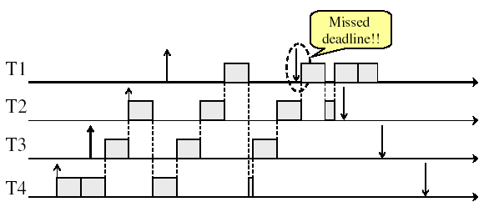
Prior scheduling policies don’t apply here
Need to account for deadlines!
Round Robin example

Slide 26
Types of real-time jobs
Aperiodic
Jobs we are already accustomed to
Unpredictable start times, no deadlines (not real-time)
Sporadic
Unpredictable start time, has a deadline
Must decide feasibility at runtime and either accept or reject job
Periodic (we’ll focus on these)
Recurs at a certain time interval
Deadline for completion is before the start of the next time interval
i.e. deadline equals the period
Can decide feasibility of schedule at compile-time

Slide 27
Periodic real-time jobs
Repeat at their deadline
New work cannot be started until the deadline
Work can take place anytime between deadlines
But MUST finish before the deadline hits
Computation
Computation
Compu
tation
Job arrives
Deadline
and
new arrival
Deadline
and
new arrival
Deadline
and
new arrival

Slide 28
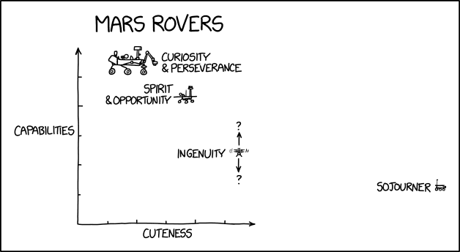
Break + xkcd
https://xkcd.com/2433/

Slide 29
Outline
Real Time Operating Systems
Earliest Deadline First scheduling
Rate Monotonic scheduling
Modern Operating Systems
Linux O(1) scheduler
Lottery and Stride scheduling
Linux Completely Fair Scheduler

Slide 30
Earliest Deadline First (EDF) Scheduling
Priority scheduling with pre-emption
Highest priority given to task with soonest deadline
Task = (Period, Duration)
Initial arrival
Deadline
0
5
10
15

Slide 31
Earliest Deadline First (EDF) Scheduling
Priority scheduling with pre-emption
Highest priority given to task with soonest deadline
Task = (Period, Duration)
Initial arrival
Deadline
0
5
10
15

Slide 32
Earliest Deadline First (EDF) Scheduling
Priority scheduling with pre-emption
Highest priority given to task with soonest deadline
Task = (Period, Duration)
Initial arrival
Deadline
0
5
10
15

Slide 33
Earliest Deadline First (EDF) Scheduling
Priority scheduling with pre-emption
Highest priority given to task with soonest deadline
Task = (Period, Duration)
Initial arrival
Deadline
0
5
10
15

Slide 34
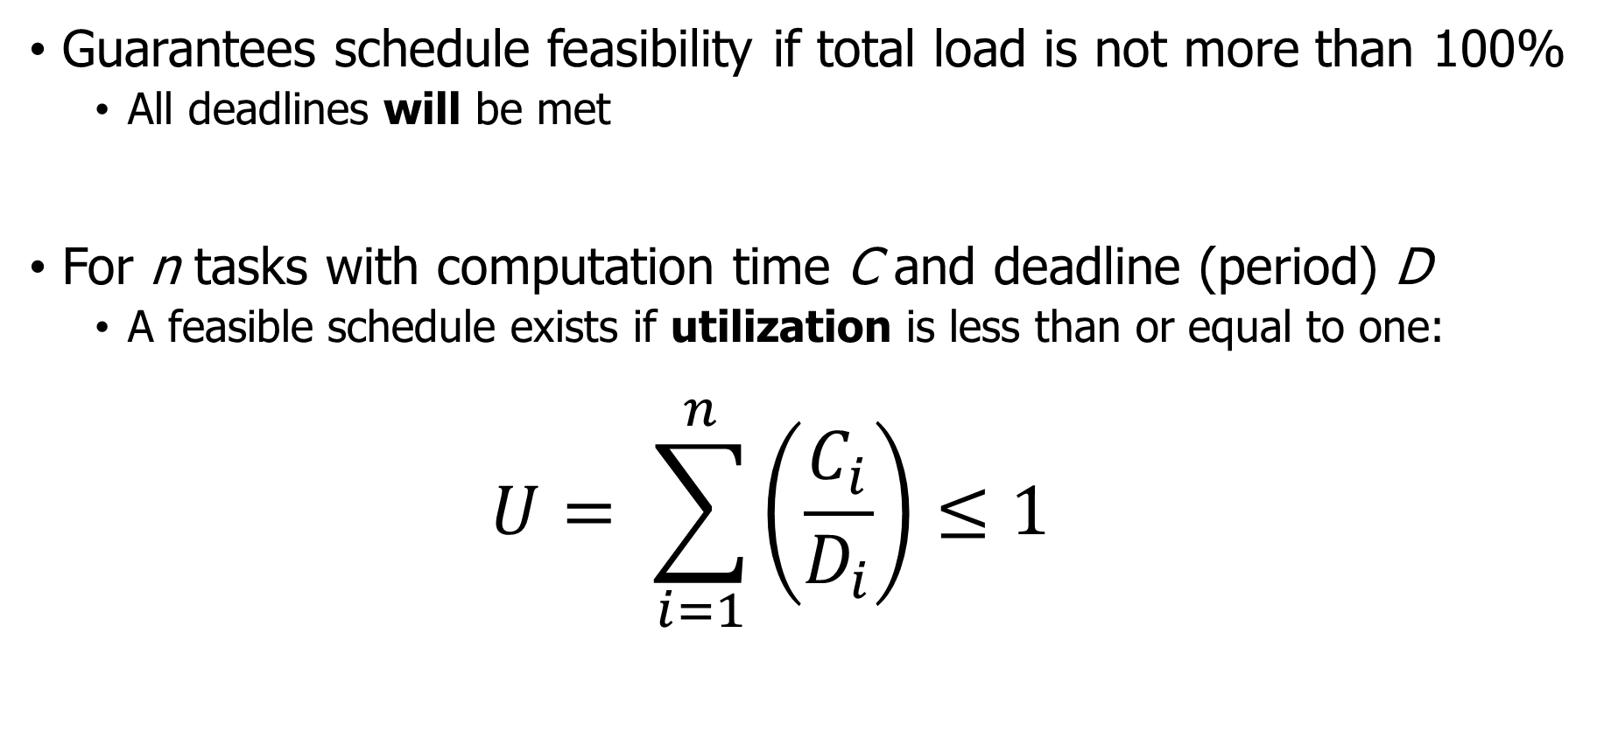
Schedulability test for EDF
Guarantees schedule feasibility if total load is not more than 100%
All deadlines will be met
For n tasks with computation time C and deadline (period) D
A feasible schedule exists if utilization is less than or equal to one:
$$U= \sum_{i=1}^{n}{\left(\frac{C_{i}}{D_{i}}\right)}≤1$$

Slide 35
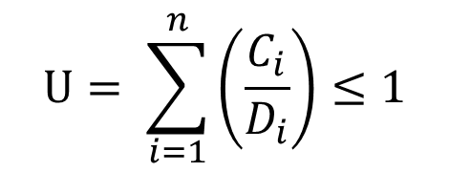
Check your understanding
Can we schedule the following workload?
Job A: period 3, computation 1
Job B: period 5, computation 2
Job C: period 15, computation 4
$$U= \sum_{i=1}^{n}{\left(\frac{C_{i}}{D_{i}}\right)}≤1$$
A
B
C
0
5
10
15

Slide 36
Check your understanding
Can we schedule the following workload?
Job A: period 3, computation 1
Job B: period 5, computation 2
Job C: period 15, computation 4
$$U= \sum_{i=1}^{n}{\left(\frac{C_{i}}{D_{i}}\right)}≤1$$
1/3 + 2/5 + 4/15 = 1
A
B
C
0
5
10
15

Slide 37
Check your understanding
Can we schedule the following workload?
Job A: period 3, computation 1
Job B: period 5, computation 2
Job C: period 15, computation 4
$$U= \sum_{i=1}^{n}{\left(\frac{C_{i}}{D_{i}}\right)}≤1$$
1/3 + 2/5 + 4/15 = 1
A
B
C
0
5
10
15
Can’t start a job before its period

Slide 38
Check your understanding
Can we schedule the following workload?
Job A: period 3, computation 1
Job B: period 5, computation 2
Job C: period 15, computation 4
$$U= \sum_{i=1}^{n}{\left(\frac{C_{i}}{D_{i}}\right)}≤1$$
1/3 + 2/5 + 4/15 = 1
A
B
C
0
5
10
15
Earliest deadline changes, preempting Job B

Slide 39
Check your understanding
Can we schedule the following workload?
Job A: period 3, computation 1
Job B: period 5, computation 2
Job C: period 15, computation 4
$$U= \sum_{i=1}^{n}{\left(\frac{C_{i}}{D_{i}}\right)}≤1$$
1/3 + 2/5 + 4/15 = 1
A
B
C
0
5
10
15
Schedule repeats at least common multiple

Slide 40
Check your understanding
Can we schedule the following workload?
Job A: period 2, computation 1
Job B: period 3, computation 1
Job C: period 4, computation 1
$$U= \sum_{i=1}^{n}{\left(\frac{C_{i}}{D_{i}}\right)}≤1$$
A
B
C
0
5
10
15

Slide 41
Check your understanding
Can we schedule the following workload?
Job A: period 2, computation 1
Job B: period 3, computation 1
Job C: period 4, computation 1
$$U= \sum_{i=1}^{n}{\left(\frac{C_{i}}{D_{i}}\right)}≤1$$
1/2 + 1/3 + 1/4 = 1.08
A
B
C
0
5
10
15

Slide 42
Check your understanding
Can we schedule the following workload?
Job A: period 2, computation 1
Job B: period 3, computation 1
Job C: period 4, computation 1
$$U= \sum_{i=1}^{n}{\left(\frac{C_{i}}{D_{i}}\right)}≤1$$
1/2 + 1/3 + 1/4 = 1.08
A
B
C
0
5
10
15
Missed deadline!

Slide 43
Break + Thinking
Where do the job deadlines come from? Provide an example.

Slide 44
Break + Thinking
Where do the job deadlines come from? Provide an example.
Real-world constraints!
Autonomous vehicle:
“If I don’t finish the detection algorithm by time N, then I will no longer be able to stop in time to avoid what it detects.”
In this example, deadline might vary with velocity, or maybe we just choose a deadline based on fastest velocity.

Slide 45
Outline
Real Time Operating Systems
Earliest Deadline First scheduling
Rate Monotonic scheduling
Modern Operating Systems
Linux O(1) scheduler
Lottery and Stride scheduling
Linux Completely Fair Scheduler

Slide 46
Earliest Deadline First tradeoffs
Good qualities
Simple concept and simple schedulability test
Excellent CPU utilization
Bad qualities
Hard to implement in practice
Need to constantly recalculate task priorities
CPU time spent in scheduler needs to be counted against load
Unstable: Hard to predict which job will miss deadline
Utilization was greater than 1, so we knew there was a problem
But we had to work out the whole schedule to see Job C missed

Slide 47
Rate Monotonic Scheduling (RMS)
Priority scheduling
Assign fixed priority of 1/Period for each job
Makes the scheduling algorithm simple and stable
Only lowest priority jobs might miss deadlines
If any fixed-priority scheduling algorithm can schedule a workload, So can Rate Monotonic Scheduling
There could be dynamic-priority systems that beat it
But they would be more complicated and take more cycles to run

Slide 48
Rate Monotonic Scheduling example
Schedule the following workload with RMS
Job A: period 3, computation 1 -> Priority 1/3
Job B: period 5, computation 2 -> Priority 1/5
A
B
0
5
10
15

Slide 49
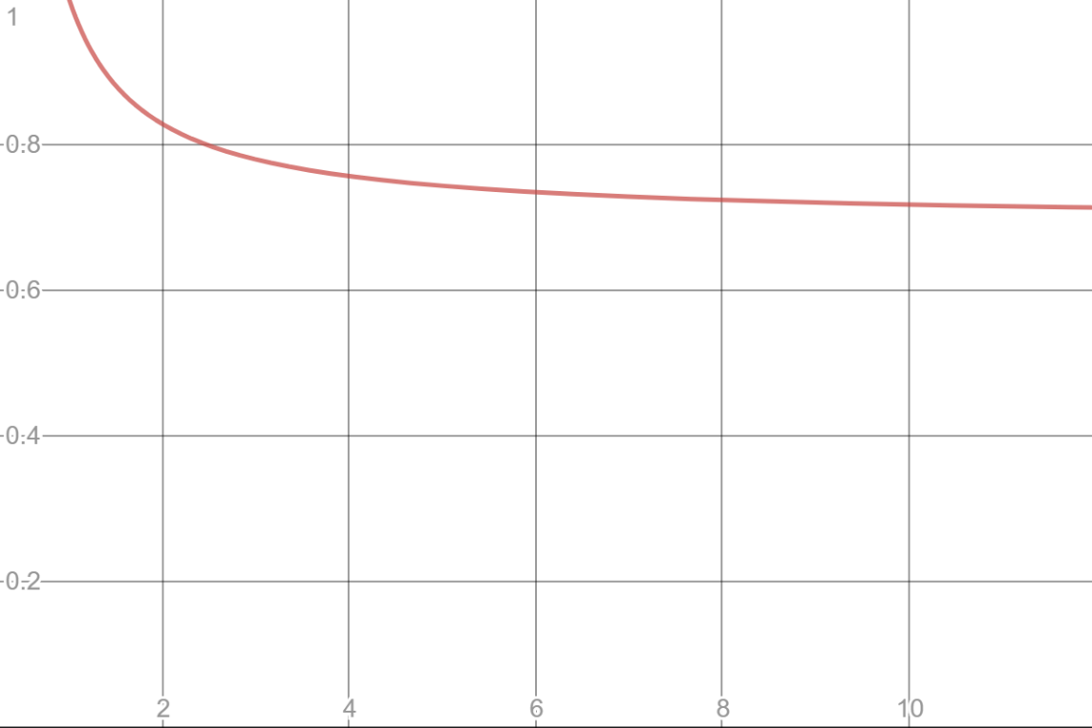
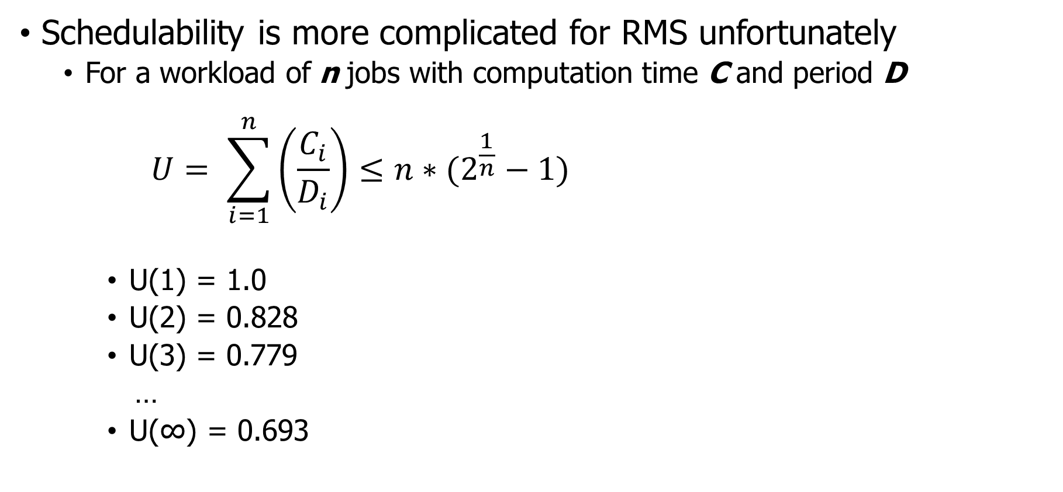
Schedulability test for RMS
Schedulability is more complicated for RMS unfortunately
For a workload of n jobs with computation time C and period D
$$U= \sum_{i=1}^{n}{\left(\frac{C_{i}}{D_{i}}\right)}≤{n∗(2}^{\frac{1}{n}}−1)$$
U(1) = 1.0
U(2) = 0.828
U(3) = 0.779
…
U(∞) = 0.693
Lower Bound on schedulability

Slide 50
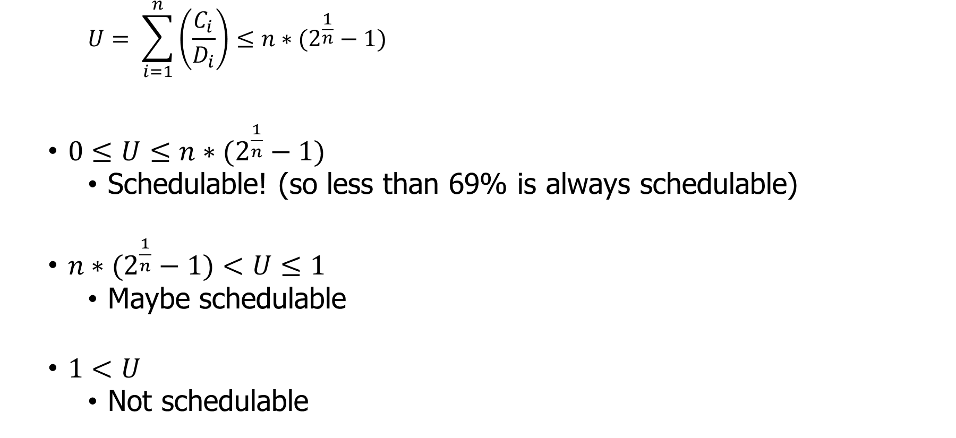
RMS schedulability test is conservative
$$U= \sum_{i=1}^{n}{\left(\frac{C_{i}}{D_{i}}\right)}≤{n∗(2}^{\frac{1}{n}}−1)$$
$0≤U≤{n∗(2}^{\frac{1}{n}}−1)$
Schedulable! (so less than 69% is always schedulable)
${n∗(2}^{\frac{1}{n}}−1)<U≤1$
Maybe schedulable
$1<U$
Not schedulable

Slide 51
Check your understanding
Can we schedule the following workload with RMS?
Job A: period 3, computation 1
Job B: period 5, computation 2
Job C: period 15, computation 4
A
B
C
0
5
10
15

Slide 52
Check your understanding
Can we schedule the following workload with RMS?
Job A: period 3, computation 1
Job B: period 5, computation 2
Job C: period 15, computation 4
1/3 + 2/5 + 4/15 = 1
U = 1 Maybe schedulable!
A
B
C
0
5
10
15

Slide 53
Check your understanding
Can we schedule the following workload with RMS?
Job A: period 3, computation 1 -> Highest priority
Job B: period 5, computation 2 -> Middle priority
Job C: period 15, computation 4 -> Lowest priority
1/3 + 2/5 + 4/15 = 1
U = 1 Maybe schedulable!
A
B
C
0
5
10
15

Slide 54
Rate Monotonic Scheduling tradeoffs
Upsides
Still conceptually simple
Easy to implement
Stable (lower priority jobs will fail to meet deadlines in overload)
Downsides
Lower CPU utilization
Might not be able to utilize more than 70% of the processor
Non-precise schedulability analysis

Slide 55
Break + Open Question
How would you handle sporadic jobs in these systems?
Unpredictable start time, has a deadline, not repeated

Slide 56
Break + Open Question
How would you handle sporadic jobs in these systems?
Unpredictable start time, has a deadline, not repeated
Must decide feasibility at runtime and either accept or reject job
Calculate new Utilization accounting for the additional job
Determine whether the schedule will definitely (or maybe) work
Schedule or reject the job
If scheduled, works just like any other job
Either EDF based on deadline of the job
Or given an RMS priority, based on period (duration)

Slide 57
Outline
Real Time Operating Systems
Earliest Deadline First scheduling
Rate Monotonic scheduling
Modern Operating Systems
Linux O(1) scheduler
Lottery and Stride scheduling
Linux Completely Fair Scheduler

Slide 58
Priority scheduling policies
Systems may try to set priorities according to some policy goal
MLFQ Example:
Give interactive jobs higher priority than long calculations
Prefer jobs waiting on I/O to those consuming lots of CPU
Try to achieve fairness:
elevate priority of threads that don’t get CPU time (ad-hoc, bad if system overloaded)
Priority 3
Job 1
Job 2
Job 3
Priority 2
Job 4
Priority 1
Priority 0
Job 5
Job 6
Job 7

Slide 59
Linux O(1) scheduler (Linux 2.6)
Goals
Keep the runtime of the scheduler itself short
Avoid O(n) algorithms
Instead, only adjust a single job when it is swapped
Predictable algorithm
Identify interactive versus noninteractive processes with heuristics
Processes with long average sleep time get a priority boost
Note my machines right now:
Ubuntu VM: 332 processes (867 threads)
Windows: 224 processes (2591 threads)
MacOS: 430 processes (2249 threads)
Major concern: many processes mean O(n) could be long…
Notes:
Linux Big O of 1 scheduler

Slide 60
Priority in Linux O(1) scheduler
MLFQ-Like Scheduler with 140 Priority Levels
40 for user tasks, 100 soft “realtime” tasks
Timeslice depends on priority – linearly mapped onto timeslice range
Kernel/Realtime Tasks
User Tasks
0
100
139

Slide 61
Workings of the O(1) scheduler
Round robin at priority levels like MLFQ
Each priority level gets a run quota
On expiration of quota
Recalculate priority
Insert in expired queue
When all jobs are gone from active queue
Swap expired and active queue pointers

Slide 62
Priorities can lead to starvation
The policies we’ve studied so far:
Always prefer to give the CPU to a prioritized job
Non-prioritized jobs may never get to run
But priorities were a means, not an end
The goal was to serve a mix of CPU-bound, I/O bound, and Interactive jobs effectively on common hardware
Give the I/O bound ones enough CPU to issue their next file operation and wait (on those slow discs)
Give the interactive ones enough CPU to respond to an input and wait (on those slow humans)
Let the CPU bound ones grind away without too much disturbance

Slide 63
Idea: proportional-share scheduling
Many of the policies we’ve studied always prefer to give CPU to a prioritized job
Non-prioritized jobs may never get to run
Instead, we can share the CPU proportionally
Give each job a share of the CPU according to its priority
Low-priority jobs get to run less often
But all jobs can at least make progress (no starvation)

Slide 64
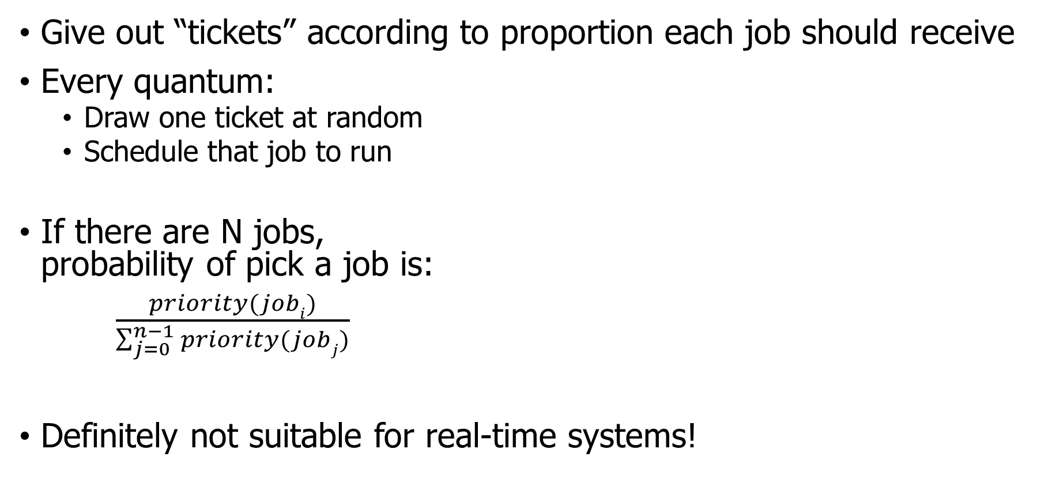
First attempt: lottery scheduling
Give out “tickets” according to proportion each job should receive
Every quantum:
Draw one ticket at random
Schedule that job to run
If there are N jobs, probability of pick a job is:
$\frac{priority(jobi)}{\sum_{j=0}^{n−1}{priority(jobj)}}$
Definitely not suitable for real-time systems!
10
1

Slide 65
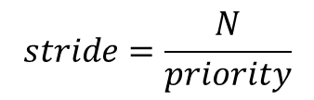
Better idea: stride scheduling
Same idea, but remove the random element
Give each job a stride number inversely proportional to priority
Priority: A=100, B=50, C=10
Stride: A=1, B=2, C=10
Scheduler
Pick job with lowest cumulative strides and run it
Increment its cumulative strides by its stride number
Essentially: low-stride (high-ticket) jobs get run more often
But starvation is no longer possible
$$stride=\frac{N}{priority}$$
Where N is some arbitrary large number
This example: 100

Slide 66
Stride scheduling example
Workload
Priority: A=100, B=50, C=10
Stride: A=1, B=2, C=10
Dynamic Priority (a.k.a. Pass)
Step
A
B
C
Result
1
0
0
0
A
2
1
0
0
B
3
1
2
0
C
4
1
2
10
A
5
2
2
10
A
6
3
2
10
B
7
3
4
10
A

Slide 67
Proportional-share scheduling is impossible instantaneously
Goal: each process gets an equal share of processor
N threads “simultaneously” execute on 1/N^{th} of processor
Doesn’t work in the real world
Jobs block on I/O
OS needs to give out timeslices
At any time t we want to observe:
CPU Time
t/N
T₁
T₂
T₃

Slide 68
Linux Completely Fair Scheduler (CFS)
What if we make shares proportional over a longer period?
Track processor time given to job so far
Scheduling decision
Choose thread with minimum processor time to schedule
“Repairs” illusion of fairness
Update processor time when the job finishes
Timeslice expiration is a big update
Blocking I/O results in maintaining small processor time
T₁
CPU Time
t/N
T₃
T₂

Slide 69
Linux CFS: responsiveness and throughput
Constraint 1: target latency
Want a maximum duration before a job gets some service
Dynamically set timeslice based on number of jobs
Quanta = Target_latency / N
20 ms max latency => 5 ms timeslice for 4 jobs, or 0.1 ms for 200 jobs

Slide 70
Linux CFS: responsiveness and throughput
Constraint 1: target latency
Want a maximum duration before a job gets some service
Dynamically set timeslice based on number of jobs
Quanta = Target_latency / N
20 ms max latency => 5 ms timeslice for 4 jobs, or 0.1 ms for 200 jobs
Check your understanding. What’s the problem here?

Slide 71
Linux CFS: responsiveness and throughput
Constraint 1: target latency
Want a maximum duration before a job gets some service
Dynamically set timeslice based on number of jobs
Quanta = Target_latency / N
20 ms max latency => 5 ms timeslice for 4 jobs, or 0.1 ms for 200 jobs
Check your understanding. What’s the problem here?
Timeslice needs to stay much greater than context switch time

Slide 72
Linux CFS: responsiveness and throughput
Constraint 1: target latency
Want a maximum duration before a job gets some service
Dynamically set timeslice based on number of jobs
Quanta = Target_latency / N
20 ms max latency => 5 ms timeslice for 4 jobs, or 0.1 ms for 200 jobs
Constraint 2: avoid excessive overhead
Don’t want to spend all our time context switching if there are many jobs
Set a minimum length for timeslices
Quanta = max(Target_latency/N, minimum_length)

Slide 73
CFS priorities are applied as “virtual runtime”
B is higher priority than A
Virtual runtime doesn’t have to match wall time
Create a conversion from actual runtime to virtual runtime
High priority jobs: 1 second realtime -> 0.5 seconds virtual time
Low priority jobs: 1 second realtime -> 2 seconds virtual time
Scheduler makes decisions solely based on equal virtual runtime
B
Physical
CPU Time
A
Virtual
CPU Time
B
A

Slide 74
Multicore scheduling
Affinity scheduling: once a thread is scheduled on a CPU, OS tries to reschedule it on the same CPU
Cache reuse
Grouping threads could help or hurt…
Implementation-wise, helpful to have per-core scheduling data structures
Each core can make its own scheduling decisions
Can steal work from other cores, if nothing to do

Slide 75
Active work in scheduling
Getting scheduling right on multicore can be difficult
No way to know whether a process will be more I/O or CPU bound in the future
Want to keep threads on the same core, but also not waste cores
In 2016, researchers found issues in Linux scheduler implementation that lead to 13%+ slowdown in jobs
https://blog.acolyer.org/2016/04/26/the-linux-scheduler-a-decade-of-wasted-cores/
Another metric: energy use

Slide 76
Summary on schedulers
If You care About: | Then Choose:
CPU Throughput | First-In-First-Out
Average Turnaround Time | Shortest Remaining Processing Time
Average Response Time | Round Robin
Favoring Important Tasks | Priority
Fair CPU Time Usage | Linux CFS
Meeting Deadlines | EDF or RMS

Slide 77
Outline
Real Time Operating Systems
Earliest Deadline First scheduling
Rate Monotonic scheduling
Modern Operating Systems
Linux O(1) scheduler
Lottery and Stride scheduling
Linux Completely Fair Scheduler

Slide 78
Bonus

Slide 79
A problem with priority schedulers: priority inversion
Other concepts from OS still apply when we’re scheduling
Particularly locks and synchronization
Imagine Task 1 and Task 3 both need to share a lock
Release lock
Task 1 is waiting on Task 2!!
Task 1
Acquire lock
Priority
block
done
Task 2
preempt
preempt
release
Task 3
0
2
4
6
8
10

Slide 80
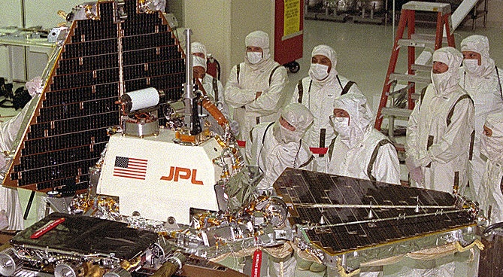
Priority inversion occurred on Pathfinder!
Bus management missed deadlines while waiting on meteorology because medium-priority tasks were taking too long
System rebooted when deadline was missed
Manage Bus
Priority
block
done
Comms
preempt
preempt
release
Weather
0
2
4
6
8
10
Notes:
Glenn Reeves is the guy at JPL who wrote up the report on this
Still there working on flight software as of 2013 (and happy to talk to summer interns about it!)

Slide 81
Priority inheritance solution to priority inversion
A solution is to temporarily increase priority for tasks holding resources that high priority tasks need
Task 3 inherits priority of Task 1 while holding lock Task 1 needs
Release lock
Task 1
done
Acquire lock
Priority
Task 2
preempt
block
release
Preempted by Task 3
done
Task 3
At Priority 1
0
2
4
6
8
10

